Slide 1
INTELLIGENT AUTOMATION (IA)
The bridge between business and technology
Presentation by Y SHRIYA SRAVANI
20BD1A66C0

Slide 2
Contents
Introduction to AI, IoT & Automation
Need for Intelligent Automation
What is Intelligent Automation?
Components of Intelligent Automation
How does Intelligent Automation work?
Benefits of Intelligent Automation
Adoption challenges
Real-World Application
Way Forward
Embracing Intelligent Automation

Slide 3
Introduction to AI, IoT & Automation
Artificial Intelligence (AI)
Artificial intelligence leverages computers and machines to mimic the problem-solving and decision-making capabilities of the human mind.
AI generates, categorizes and interprets data as per the user’s requirement.
AI is a vast domain that consists of Machine learning (ML), Deep learning (DL) and Natural Language Processing (NLP),etc.
It is used in various other domains like Data Science, IoT , Cyber Security, etc to enhance the flexibility and range of problem-solving capabilities.
One such domain that uses AI extensively is IoT.
Internet of Things(IoT)
Internet of things is the bridge between technology and connected devices where these devices can be connected to the cloud or with each other.
Notes:
While IoT has already significantly impacted our lives, integrating AI into IoT systems is the likely next step in its evolution, with its potential to help IoT systems become more efficient and effective.
IOT- automation
AI- decision-making process
AI has become increasingly useful in every domain known to man.

Slide 4
It has been in popularity for many years but only recently, with the coming of AI, IoT has advanced to a new level.
By introducing IoT to automation, processes are easier to complete and the accuracy of working is increased.
Automation
Automation is the creation and application of technologies to produce and deliver goods and services with minimal human intervention.
Automation optimizes the resources used which allows humans to do more creative work or work that deals with edge cases and improving processes.
It allows for faster processing of repetitive tasks and shorter turnaround times.
Automation is used widely in enterprise applications like business process automation (BPA), IT automation, network automation, automating integration between systems and industrial automation such as robotics.
Notes:
Automation is the use of technology to perform tasks where human input is minimized.
This includes enterprise applications :- business process automation (BPA), IT automation, network automation, automating integration between systems, industrial automation such as robotics
It has some disadvantages:- initial cost, flexibility less as tools are made for specific purpose.

Slide 5
Need for Intelligent Automation
While IoT has significantly impacted our lives, integrating AI into IoT systems is the next likely step in its evolution, with its potential to help IoT systems become more efficient and effective.
Less flexible to changes :-
Changes require human intervention and monitoring.
High implementation cost :-
A balance must be maintained between initial cost and future cost savings.
Process created for specific task :-
-Same process cannot be used in different contexts.
-In some cases automated processes require additional learning to know how to handle a situation.
Accuracy Improvement:-
Use of AI improves decision-making which results in precise outputs.
Notes:
While IoT has significantly impacted our lives, integrating AI into IoT systems is the next likely step in its evolution, with its potential to help IoT systems become more efficient and effective.
Handling changes is difficult ; improve data management effectively
Tasks done repetitively on a daily or weekly basis work efficiently when implemented using automation while those executed once every few months do not require automation
Teaser - need was felt to apply AI to automation systems enhancing the capabilities and efficiency of systems.

Slide 6
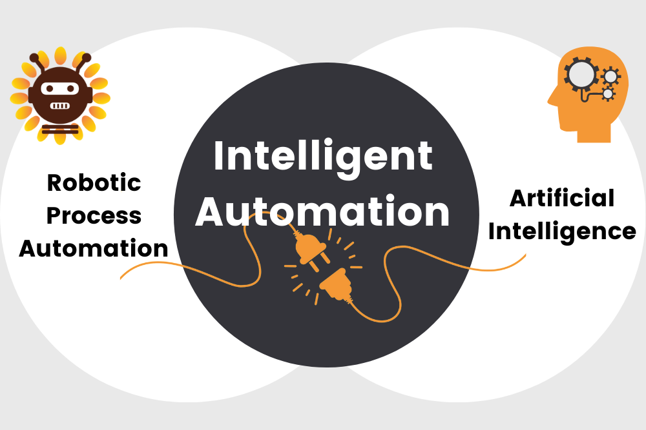
Intelligent Automation
The term “Intelligent Automation” (IA) was first coined by Forrester Research to describe tools that support enterprise automation in business process management.
One of the earliest forms of intelligent automation is process mining software that was developed in the late 1990s to automate process analysis and process discovery in business operations.
IA is an end-to-end solution that combines Robotic Process Automation(RPA) and Artificial Intelligence to provide many benefits that aid in the digital transformation of an organization.
RPA automates processes that use data and logic, while AI is the process behind the effort to stimulate human intelligence in machines.
Use of intelligent tools like chatbots equips organizations with key insights that help in faster response to customers. For Example, Optical Character Recognition is used to automate text analysis and drive better decision-making.
Notes:
IA introduced to Overcome automation problems.
IA -> Hyperautomation
IA improves accuracy and efficiency powered by an informed knowledge base.
It can also track and automate processes and workflows, and because it’s “intelligent,” it can make decisions and learn as it goes.

Slide 7
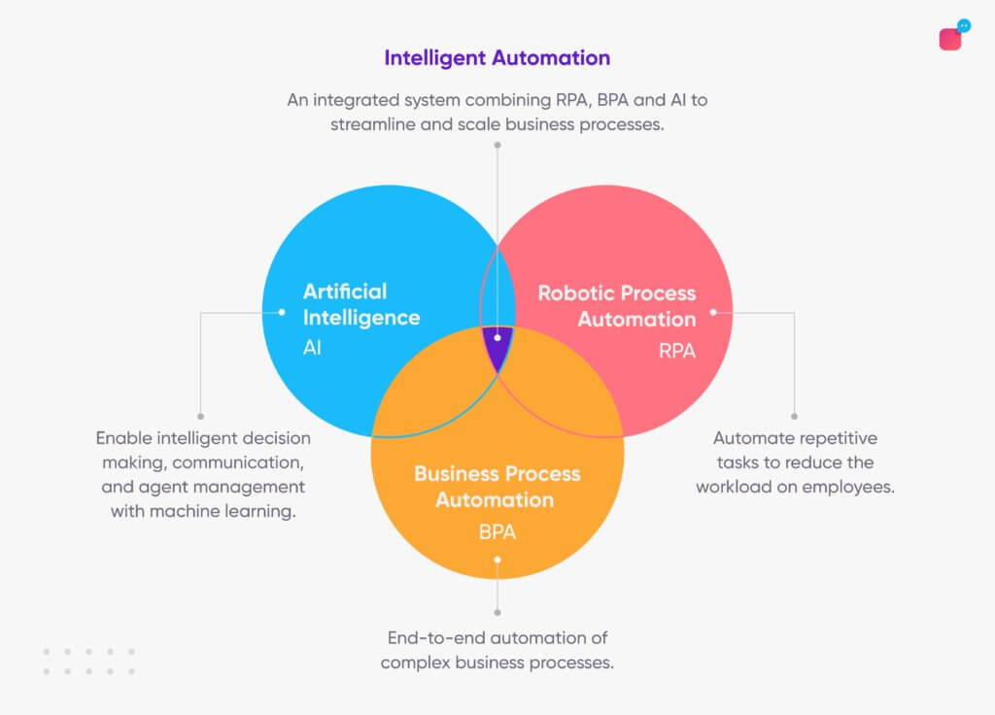
Components of IA
Robotic Process Automation(RPA) :- It is an integral part of IA. In RPA, a software robot mimics human action to perform rule-based, repetitive tasks. They can open, move, edit copy files, extract information.
Artificial Intelligence(AI) :- AI is a developing system that analyses and performs operations on their own concerning the environment.
Intelligent Business Automation :- It is a field of Automation in which rather than automating a single individual task, a whole end-to-end business process is automated.
Network Connectivity :- The Internet is essential in today's world for each industry. As everything is moving to the cloud, connectivity is a vital component of Intelligent Automation.
Notes:
RPA is an integral part of Hyperautomation.
AI machines learn from experience by building own problem-solving models
AI 3 parts – sensors, environment, Learning model

Slide 8
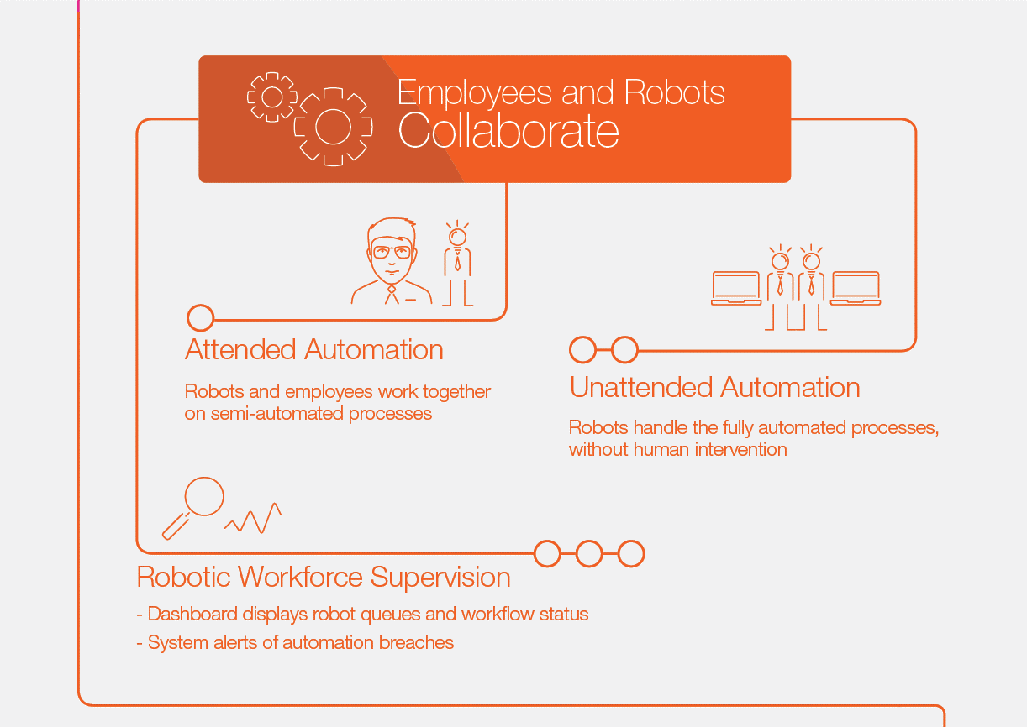
How does RPA work
RPA works in 2 ways depending on the enterprise and the needed solution.
One way is through connections to databases and enterprise web services in the backend.
The other way is through front end or desktop connections that take multiple forms.
Layered approach: different parts of a process automation are divided into different layers, each responsible for certain functionalities
AI- powered RPA
It is used for advanced automation such as OCR, Text Analysis, etc.
Cognitive automation uses OCR , chatbots and Machine Learning technologies, to support the automation of more complex business processes.
With machine learning, the automation process has the ability to learn, expand capabilities, and continually improve certain aspects of its functionality on its own.
Notes:
Most used is backend; unattended automation is done
Where attended and unattended RPA excel with processes that leverage information from structured databases
CA- describes diverse ways of combining artificial intelligence (AI) and process automation capabilities to improve business outcomes.
Cognitive automation can also tap into unstructured data sources like scanned documents, emails and letters.

Slide 9
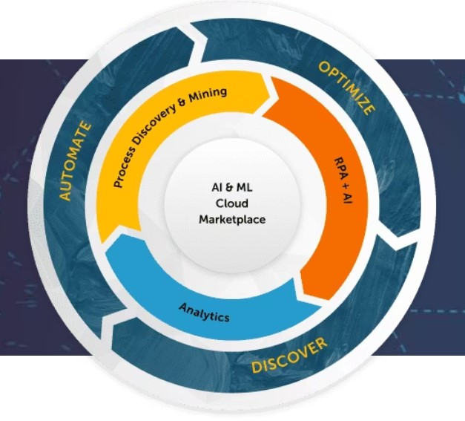
How does IA work?
AI utilizes information gathered from various sources and feeds that information to tools and products to increase the value of their interactions.
RPA provides value to automating processes based on structured data many of which required manual intervention.
IA helps in making business-data-driven decisions by empowering the employees with Intelligent Automation tools while giving access to advanced analytics and visualized data.
The use of both structured and unstructured data and the automation of repetitive processes ensures better decision-making, and less human intervention results in more precise results.
Customers’ needs are better understood and communication is done more effectively so that higher-quality products are brought into the market.
Notes:
Aristotle believed, in reference to human perception, “the whole is greater than the sum of its parts.” - The extension of RPA with embedded AI capabilities epitomizes this statement.
But the combination of the two (i.e., IA) provides tremendous value in creating solutions that use a technological knowledge base to streamline processes and interactions between applications.

Slide 10
Benefits of IA
Automate any business process, end-to-end :- Save time and money by reducing human interaction, increasing processing speed, and regularizing outputs.
Reduce operational obstacles :- RPA + AI can navigate legacy systems and other functional barriers and connect front-office and back-office operations.
Organize and process complex data :- Intelligent automation tools capture, store, manipulate, and retrieve records from unstructured sources, ensuring processes run successfully.
Eliminate Errors and Exceptions :- Digital workers improve efficiency and accuracy of both routine tasks and complex procedures. Over time, intelligent bots continue to decrease exceptions by self-learning how to handle them on their own.
Enhance Customer Experience :- Improve customer satisfaction by delivering faster response times, greater accuracy, and more consistent results.
Ensure Compliance :- Intelligent automation enables guaranteed adherence to requirements established by regulatory statutes, industry standards, and best practices.
Liberate employees :- With intelligent Digital Workers handling more complex tasks and complete processes, employees can focus on objectives that use their unique human skills.
Notes:
Saves time
Data analysis & prediction-goal measuring
Boosting customer experience

Slide 11
IA Adoption Challenges
Adopting IA is not without challenges. However, those challenges can be effectively remedied.
Some of the challenges include the following:
Skillset and knowledge gaps are remedied through retraining staff or partnership with a PaaS vendor who sets your IA in motion and manages it for you.
Process ambiguity is a challenge if processes within the organization are not well understood. Process mining and process discovery remedy this challenge by helping businesses with process mapping — a necessity before embarking on an IA implementation.
Lack of focus on standardization is faced by anyone implementing IA. No standard approach to automation exists, so each automation product vendor may approach the same process differently. This can be challenging if an organization decides to switch vendors. With so many vendors and organizations discussing this challenge, hopefully standards are forthcoming.
Contd..

Slide 12
IA Adoption Challenges
Difficulty identifying opportunities and developing an automation platform is a challenge that a partner can address. Many types of partners solve this, from SaaS (Software as a Service) vendors to Platform as a Service vendors, to systems integrators — they select the solution and the automation software that works best for your organization.
Inadequate tools to develop and execute an end-to-end solution can halt the adoption of IA before it begins. If an organization has the skills in-house or can retrain existing team members, they can ensure the proper RPA tools, such as software robots, are put in place. This can also be remedied through partnership.

Slide 13
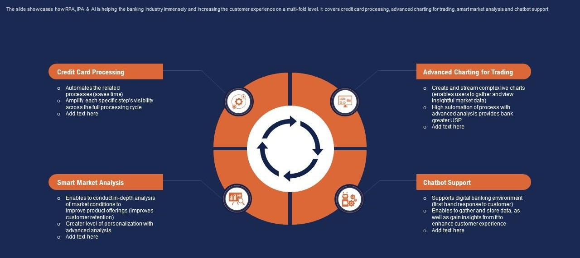
Real-World Application
Organizations are leveraging this technology to automate tasks such as data entry, customer support, supply chain management, and quality control.
Intelligent automation within financial services orchestrates your entire banking operations, monitoring and improving automations as they run to ensure the highest efficiency, cost savings, and time to value. IA helps reduce operational costs, but it also reduces operational risks, which are often caused by human errors.
IA helps banks remove repetitive tasks, improve efficiency, reduce costs, and enhance customer service, etc. And as the financial sector evolves, IA will play an increasingly crucial role in helping banks stay competitive and meet their customers’ changing needs.
Notes:
Used in sectors like e-commerce , retail , content & visuals ,healthcare ,financial sector,transportation,businesses

Slide 14
Way Forward
The future of IA is boundless. An example of new technology being developed that uses IA to provide greater value to our daily interactions with technology is cognitive automation.
Cognitive automation is a progression of IA that uses large amounts of data, connected tools, diagnostics and predictive analytics to create solutions that mimic human behaviour. Using natural language processing (NLP), image recognition, neural networks, deep learning and other tools, cognitive automation attempts to mimic more human behaviour, including emotional reactions and other natural human interactions.
An example of cognitive automation in use is the adoption of robotics to supplement patient care in nursing homes and hospitals.
IntelligentAautomation takes IA to the next level, automating as many processes and applications as possible, using tools such as business process management to standardize the approach to automation across the organization and create even greater business value.
Notes:
IA is used by Unilever , HSBC , Alibaba ,TUI , Ernst & Young

Slide 15
Embracing Intelligent Automation
“ IA requires selection of the right tools and technologies for the challenge at hand” – Gartner
IA involves many technologies, it becomes imperative to have the right tool and technologies.
This decision depends on organization strategy, the decision-makers and teams that would be using these tools and their skills.
Tools that organization chooses has to scalable, easy to work with and interoperable with an organization's existing system.
IA is not made to replace humans; instead, it is used to leverage the capabilities and work efficiency of humans.
If adopted by automated organisations, Intelligent Automation can help them, monitor, analyse and grow for a better future.
Notes:
great way to boost efficiency and productivity in many businesses.
reduce the cost of labor
find new approaches, techniques, and optimization since any company will win from it!

Slide 16
Thank You…

